Slide 1


CITY GUIDE PROJECT
SUPERVISOR Mr.A.Malarmannan,M.E., AP/CSE.
PRESENTED BY
2303811710422150 – SINDHUJA S

Slide 2

PRESENTATION OVERVIEW
Objective
Project Introduction
Problem Statement
Methodologies (Programming concepts relevant to problem statement)
Architecture of the proposed system
List of Modules
Merits
Results and Discussion
Queries

Slide 3
OBJECTIVE
The primary objective of the City Guide Project is to develop an interactive application that allows users to explore local cities and restaurants effortlessly. The project aims to provide a user-friendly platform where users can search, add, and display cities and their associated restaurants, categorized by cuisine types. It seeks to create an organized system for managing city and restaurant data using efficient data structures like HashMap for fast retrieval and easy management.

Slide 4
PROJECT INTRODUCTION
The City Guide Application is a Java-based solution designed to assist users in exploring cities and discovering popular restaurants along with their cuisine types. This project serves as a practical example of using object-oriented programming principles and graphical user interfaces (GUIs) to solve real-world problems. This project is especially beneficial for travelers and food enthusiasts seeking curated restaurant information in different cities.

Slide 5
PROBLEM STATEMENT
In the fast-paced world of today, finding reliable information about cities and their culinary offerings can be a daunting task for travelers and food enthusiasts. Many people face difficulties in discovering the best restaurants or specific cuisines when exploring a new city. While several online resources provide general information, they often lack customization, easy accessibility, and simplicity for users who require focused data without the distractions of unrelated content.

Slide 6
Methodologies (Programming concepts relevant to problem statement)
Object-Oriented Programming (OOP):
Encapsulation: Organizing city and restaurant data using classes and encapsulating details within methods.
Inheritance and Polymorphism: Extending functionality for future expansions, such as adding new types of data (e.g., tourist attractions).
Graphical User Interface (GUI) Design:
Developing a user-friendly interface using Abstract Window Toolkit (AWT) components such as TextField, Button, TextArea to improve accessibility.

Slide 7
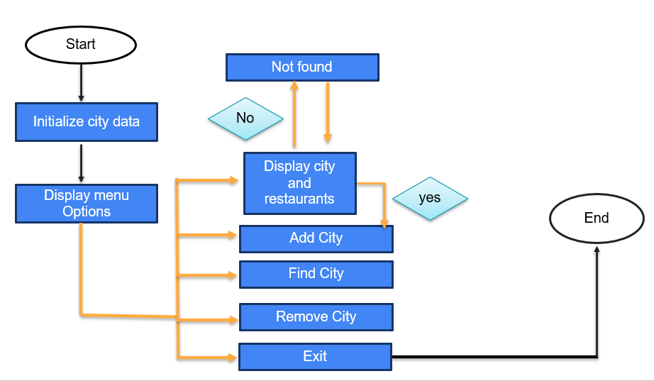
FLOW DIAGRAM

Slide 8
MODULE DESCRIPTION
User Interface Module
Input fields for entering city names, restaurant names, and cuisine types.
2. City Management Module
Predefined city initialization with restaurant data. Methods to add restaurants dynamically.
3. Restaurant Management Module
Methods for adding restaurants to existing cities. To manage restaurant details within each city.
4. Data Validation Module
Validating user inputs, such as checking if a city exists before adding a restaurant.

Slide 9
MERITS
The application provides an easy-to-navigate GUI using AWT, ensuring accessibility for users with minimal technical expertise.
Users can add, update, and retrieve city and restaurant information without modifying the code or restarting the application.
The use of HashMap ensures fast data retrieval and storage, even as the data grows, making the application scalable.

Slide 10
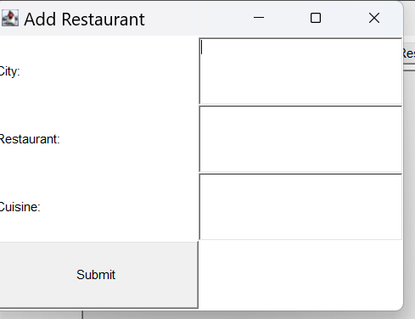
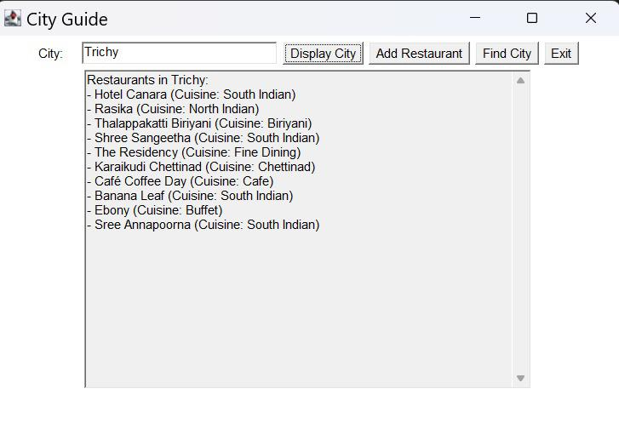
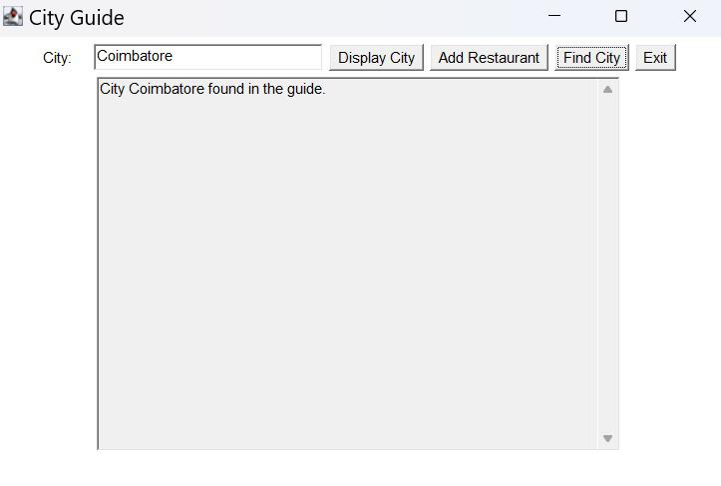
RESULT AND DISCUSSION

Slide 11
ANY QUERIES ???

Slide 12
THANK YOU!!!

